Slide 1
NJSTART For School Business Administrators
Resources/Compliance/Contracts
October 16, 2024
Notes:
Nick

Slide 2
Notes:
Nick

Slide 3
Agenda
Welcome and Introductions
DPP and Periscope – a partnership created to support you
NJSTART Support Overview
Resources and Terms
Demo: Let's Take a Look!
What we Covered and How to Contact Us
Notes:
Nick

Slide 4
Meet the Team
Our State Contract is: T2879 – eProcurement System Transformation, Contract #84203
The State of New Jersey and Periscope (formerly Periscope Holdings) have been working together since 2005. Periscope is a technology and solutions provider focused exclusively on transforming public sector procurement. For the State of New Jersey, Periscope is the technology provider and implementer for NJSTART, including the new NJSTART Marketplace, an enhanced State of New Jersey Cooperative Contracting and eprocurement shared resource for Public Purchasing Entities in New Jersey.
Bill Hnatiuk, Local Government Manager
Trevor Day, General Manager
Cheri Ray, Program Manager
Nick Susi, Senior Director Transaction Program Success
Notes:
Nick
As I mentioned in our opening, Bill and I represent NJSTART, but are from Periscope. Our company, has had a long history of working with the State of New Jersey, DPP. We will get in to the details of our contract and how that impacts you all in the next slide. Before we go there, I also want to shout out two other members of our New Jersey team that you/your team may come into contact with when being supported to use NJSTART. As I mentioned, Bill Hnatiuk is our LGM and is here to support you when you use NJSTART and want to buy from State contract. Holly Towle is our Supplier Account Manager and spends her time supporting our suppliers with State of New Jersey contracts. Last but not least is our Ops Mgr Cheri Ray who supports several of our other clients as well as NJ, but she lives in NJ and loves to support her home State. Bill is also located in New Jersey, and I am just over the Delaware River in Center City Philadelphia. We are intentionally in the region to make sure you get the support you need, whether in person or virtually

Slide 5
NJSTART – What is it?
NJSTART is The State of New Jersey’s online purchasing system for the Division of Purchase & Property (DPP)
The Division of Purchase & Property (DPP) is within the NJ Department of the Treasury and serves as the State's central procurement agency
NJSTART includes all active contracts including those open to Cooperative Purchasing Participants
DPP’s Cooperative Purchasing Program was established by legislation & extends specific State contracts to eligible local buying units
Examples of “local buying units” are Municipalities, Counties, School Districts, Volunteer Fire Departments, Volunteer First Aid & Rescue Squads, County & State Colleges, Independent Authorities, Quasi-State Agencies and Independent Institutions of Higher Education
Notes:
Nick

Slide 6
Some of Periscope’s State Contract Responsibilities
State Contract T2879 – eProcurement System Transformation - #84203
Below are just some of Periscope’s contracted responsibilities:
Train and support Cooperative Program Participants in how to use NJSTART
Market Cooperative Contracts to Cooperative buyers
Implement a supplier reporting program to enable improved visibility into Cooperative buyer habits and needs
Collect a procurement efficiency program fee to fund State procurement operations and the support of Cooperative buyers
Notes:
Nick

Slide 7
NJ State contracts ensure compliance
Division of Purchase and Property
Bid proposals are evaluated by a Procurement Bureau Procurement Specialist or Evaluation Committee based on price, terms and conditions, specifications, and other factors https://www.nj.gov/treasury/purchase/doingbusiness.shtml
The office of the State Comptroller
The Procurement Division makes sure that taxpayer dollars are protected by ensuring that contracts are competitively bid and are held to high standards of fairness and transparency in order to avoid waste, cronyism, and corruption https://www.nj.gov/comptroller/about/work/procurement/
Newsletter & Notification New Jersey Office of the State Comptroller - Subscribe for Email Updates (govdelivery.com)
Notes:
Bill

Slide 8
NJ State Contracts
Division of Purchase & Property uses the NJSTART system for all Bid solicitations
Examples can be found here https://www.njstart.gov/bso/view/search/external/advancedSearchBid.xhtml
All vendor compliance documents are collected
Bid are publicly advertised
Opening dates are published
Bids are reviewed
Public comment
Contract Awards are published
Notes:
Bill

Slide 9
NJSTART Resources

Slide 10
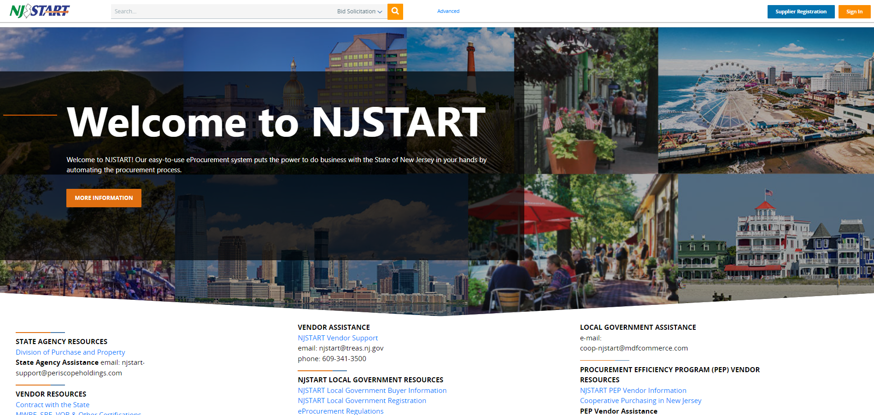
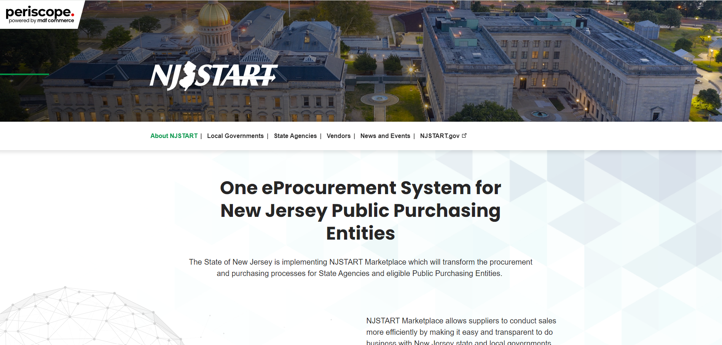
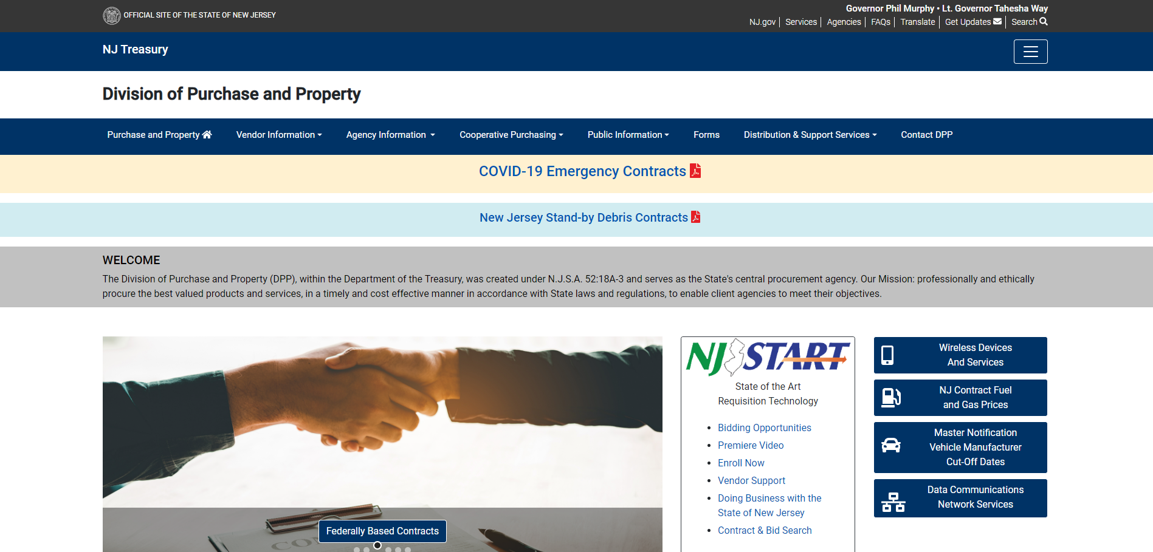
NJSTART Online Resource Pages
www.njstart.gov
Access Statewide contract details including pricing and procedures
Access select vendor G2B punchouts
Source vendors
Manage your account
Access Marketplace* (coming soon!)
Do not use Supplier Registration
www.njstart.info
NJSTART Registration Requests
FAQs
Resources for Local Governments
Quick Reference Guide
Newsletters & Recorded Training Sessions
Contracts Reports
www.nj.gov/treasury/purchase/
Access to fuel pricing
Master Notification Vehicle Manufacturer Cut Off Dates
Important Technology Contract Info
Special Notices such as notices of awards and intent to contract as well as regulatory notices

Slide 11
Sample of Contract Data in the NJSTART Quarterly Contract Report
Category and Description | Contract # | Vendor Name | NJSTART Vendor Number | Blanket Start Date | Blanket End Date | NJ Cooperative Purchasing
G2004 - FURNITURE: OFFICE, LOUNGE AND SYSTEMS – STATEWIDE | 81607 | Allseating Corporation | V00000913 | 07/30/12 | 10/31/24 | Y
M0002 Facilities Maintenance and Repair & Operations (MRO) and Industrial Supplies | 19-FLEET-00566 | Grainger | V00003164 | 10/01/18 | 12/31/24 | Y
T3121 Software Reseller Services | 20-TELE-01509 | York Telecom Corporation | V00000150 | 05/25/2021 | 05/24/2026 | Y
T0200 - MAILROOM EQUIPMENT AND MAINTENANCE VARIOUS STATE AGENCIES | 41259 | Prior & Nami Business Systems | V00001606 | 04/15/16 | 04/14/25 | Y
T0103 - Park and Playground Equipment | 16-FLEET-00139 | Liberty Parks and Playgrounds Inc | V00013839 | 05/31/17 | 05/30/25 | Y
EXAMPLE ONLY
Notes:
Bill

Slide 12
Back to School Contracts report
60 Contract portfolios
Over 300 contracts
Reports can be found at this link
Examples of Contracts
Computer/Peripherals/Software
MRO/Walk- Supplies for Home Depot & Lowes Electrical/Plumbing Supply
HVAC & Boiler Services
Library & School Supplies
Locking Hardware
Furniture/Flooring

Slide 13
Reviewing Contracts (Blankets) & Attachments in NJSTART
There are 3 types of Cooperative Contracts available
Typical Attachments Tab Contents, use in conjunction with the Items Tab
A State contract established through an advertised solicitation by DPP
For State Managed Contracts
Final Bid Solicitation
Sections 1/2/3/4/5 usually most helpful
T
G
A State contract established based on Federally-Based Contracts
For National Cooperatives
Master Agreement
Participating Addendum
A State contract established by joining an existing Cooperative Agreement
Common docs important to you
MOO Method of Operations
At-A-Glance
Award Summary
M
Notes:
Bill

Slide 14
Suggested Best Practices for utilizing NJ State Cooperative Purchasing Contracts
Validate that a contract is “Active and Purchasable.”
In NJSTART the contract shows in “Sent” status and the expiration date is future date (example 01/10/2025).
Make sure every vendor quote has the following:
SONJ Contract Number
Recommend requesting exact detail from State approved price list or Items Tab when data available.
Review the Items and Attachments tabs to make sure that pricing is the most recent pricing.
Even if the vendor tells you provided pricing is current, it cannot be used if it is not approved by the State and in NJSTART)
Validate that the items you want to purchase are the EXACT make/model/part/etc.. that is on the contract item list or price list.
Review the Vendor tab for vendor information:
Review the Distributor sub tab to validate any (reseller/distributor/fulfillment partner)
If a company is not listed, it cannot be used
Review the MBPO/contract Items tab for contract award and other clarifying information
Review the following documents found on the Attachments Tab
Note, these best practices are meant to provide general guidance. Not every document will be present on every contract
Always follow the outlined procedures and if you are uncertain of any legal requirements, consult your legal counsel
Final Bid Solicitation
Sometimes referred to Bid Solicitation, RFP, or Revised Bid Solicitation
For National Cooperative Contracts review Participating Addendum
For GSA contracts, review RFQ if available
Method Of Operations
At a Glance
Award Summary
Price List
Every contract will have some combination of these documents
Understand how to use the contract and quote requirements
This is critical with multi-vendor awards
Associated items that are NOT on State contract should have a separate quote and/or a separate purchase order.
Every purchase order must include:
NJ Cooperative Purchasing System Number “NJAC 5:34-7.29”
SONJ Contract Number (must be on all vendor quotes you receive)
REMEMBER TO ALWAYS FOLLOW YOUR LOCAL PUBLIC PURCHASING GUIDELINES!
Notes:
Nick

Slide 15
Let's Take a Look Together!
Some helpful tips when using NJSTART
Be sure to login to https://www.njstart.gov to get the best search experience
Use the Advanced Search feature to filter for cooperative contracts
Remember, in NJSTART contracts are called blankets!
Take advantage of viewing contracts with easy-to-use punch outs
The Items and Attachments Tabs have the most information needed to learn about the contract
Monitor DPP’s website for important updates: https://www.state.nj.us/treasury/purchase/
Monitor the NJSTART Info page for resources and contract guides: https://www.njstart.info
Non-State Agency Users with log in credentials to the NJSTART system are NOT able to reset their passwords themselves. If you need your password reset, please contact coop-njstart@mdfcommerce.com and your password will be reset, and a new temporary password will be generated.

Slide 16
What we covered
Maximize NJSTART’s Value to you!
NJSTART & NJ Dept. Treasury Div of Purchase & Property
NJSTART Responsibilities
Sate of NJ Bid and Contract compliance
Resources, NJ-DPP, NJSTART.Info Contract reports, Registration, Newsletter and Other useful information
Types of Contract (T/M/G) and Important Documents
Types of Searches: Contract/G2B/Vendor/Marketplace
Notes:
Bill

Slide 17
Next Steps Contact Trevor Day and Bill Hnatiuk coop-NJSTART@Mdfcommerce.com Go to our online resource Page to sign up for access to njstart.gov and our newsletters. www.njstart.info Request to schedule NJSTART Training Functionality – Navigation
Notes:
Bill

Slide 19
Thank you!

